Slide 1
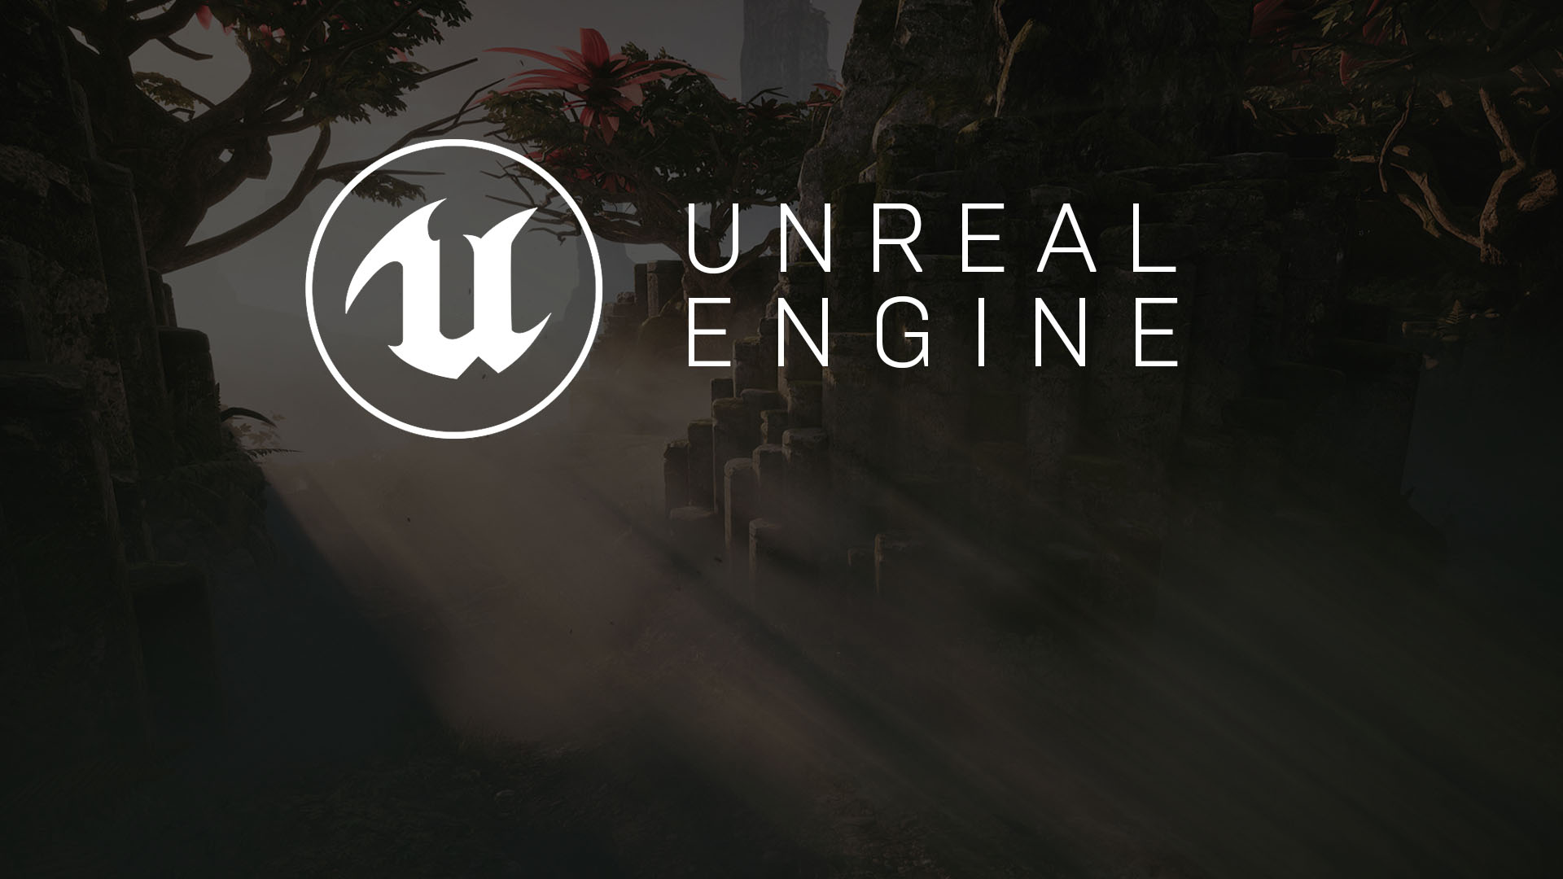
hour 3
Coordinates, Transforms, Units,
and Organization

Slide 2

Introduction
In this lecture, you will develop an understanding of how to use the grid to create content in 3D space.
First you will learn about coordinates and how to use transforms and what tools can maximize their use.
Next you will examine the grid system and the measurements that make multisoftware package information translate correctly into UE4.
Finally, you will examine some organizational systems used in UE4 to keep projects tidy and readable.

Slide 3
Lecture Goals and Outcomes
Goals
Outcomes
The goals of this lecture are to
Understand Cartesian coordinates and how they relate to UE4 transformations
Learn how to scale, move, and rotate Actors
Learn about the grid system and how to use measurements for Actors
Learn about scene organization and structure
Learn how to group, layer, and attach Actors
By the end of this lecture you will be able to
Use transforms to move, scale, and rotate Actors in the Editor
Use and modify the grid to place Actors in your Level
Organize your Levels using the World Outliner

Slide 4
Understanding Cartesian Coordinates
Understanding any type of 3D content creation requires understanding the use of three-dimensional coordinates—that is, Cartesian coordinates.
Cartesian coordinates are a system of calculations from which you can derive information or points within a given field or space.
A 3D plane uses x, y, and z coordinates. Each letter corresponds to an axis, where z is up and down, y is left to right, and x is front to back.
All 3D graphics are generated by plotting out one single point relative to specific values.
By using a string of these intersection points, you can make connections between the points to create a shape or volume. You can also use the points for manipulation and movement to plot out placement and scale of an object in 3D space.

Slide 5
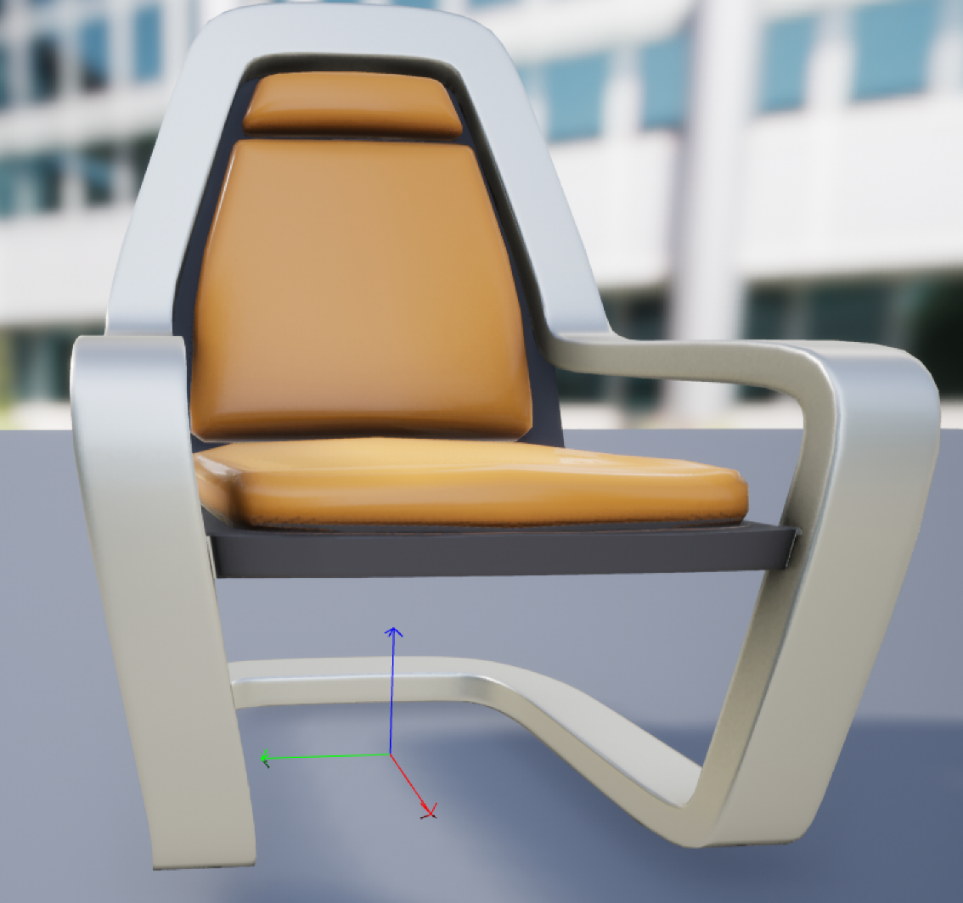
Pivot Points
Static Mesh Actors and every other Actor placed in a Level has a pivot point.
A pivot point is the local axis of an Actor. All the components that make up an Actor are relative to the Actor’s pivot point.
For example, the vertices, edges, and polygons that make up a 3D model have their position in space relative to the Actor’s pivot point.
When transforms are applied to an Actor, they are applied to an Actor’s pivot point.

Slide 6
Working with Transforms
A transformation tool manipulates or translates within the 3D space in UE4. There are three transformation types:
Move
Scale
Rotate
UE4 has color-coordinated each directional axis to make the tools easier to use.
Colors are coordinated not only with the transformation widget tool but also with many of the detail and context menus.
For instance, the manual transformation options in the Details panel also have the same correlating color scheme.

Slide 7
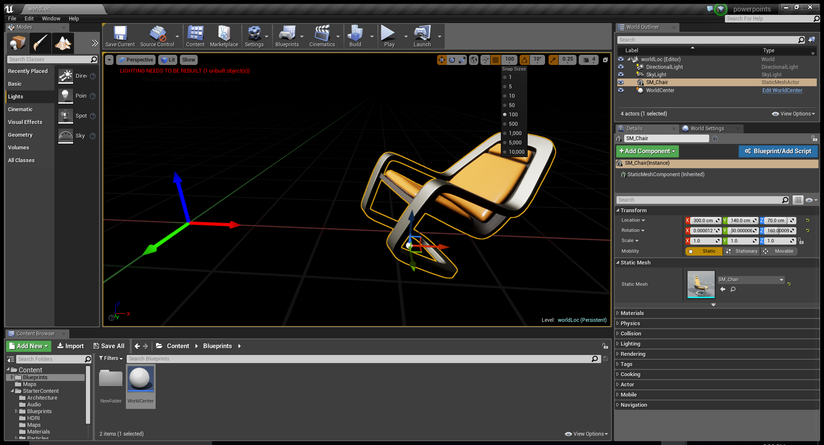
Move Transform
The Move transform gizmo allows you to move an Actor within 3D space from one location to another.
Every Actor has a specific location on the x, y, and z axes within a scene.
The coordinate location for each Actor is based on the pivot point of the Actor.
To move an Actor within the scene, you select the Actor you want to move and then select the Move transformation tool or press the W key. You can then move the Actor in any direction by left-clicking and dragging the desired arrow of the direction you would like to move and moving the directional cursor in that desired direction.
By left-clicking and dragging the mouse on the colored square located at the pivot point, between two different directions, you can move in two directions simultaneously.

Slide 8
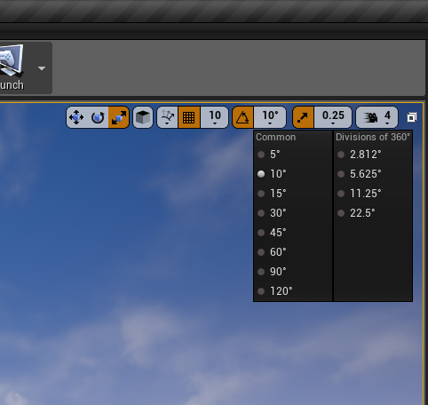
Rotate Transform
Rotation is handled the same in UE4 as in most other 3D programs: by using degrees of rotation. 360 degrees equals a full rotation, and full rotation can occur within any of the three axes, x, y, and z. Each axis is relative to a term specific to rotation:
Pitch: x
Yaw: y
Roll: z
The Rotate degree-snapping tool is located beside the other transform snapping tools. By clicking the Rotate tool, you can turn on and off snapping and set specific snap degrees.
For example, you can set an Actor to rotate and snap at 5-degree rotations or 30-degree rotations. This can be helpful when you’re using modular sets to control specific measurement rotations.

Slide 9
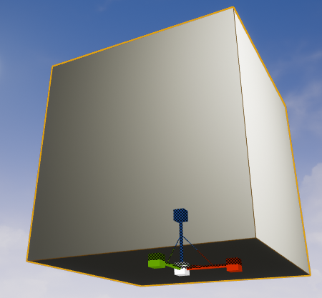
Scale Transform
When you bring an Actor into a Level directly from the Content Browser, the scale is 1 on all axes.
The Scale transform allows you to increase or decrease an Actor’s size uniformly or nonuniformly on the x, y, or z axis.
To change the scale of an Actor, select the Actor and then select the Scale transformation tool or press the R key.
By moving any of the directionally oriented scale handles, you can scale the Actor in any direction.
If you select the middle white box on the Scale transform gizmo, you can scale the Actor uniformly and in every direction at once.
Selecting any of the bars connecting two directional scaling boxes, you can scale two axes at one time.

Slide 10
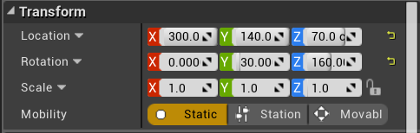
Interactive and Manual Transforms
Transformations can be done in two ways: interactive transformation and manual transformation.
Interactive transformation is the process of using the Move, Rotate, or Scale transformation gizmo to make less-than-precise changes in the world space widget. The term widget refers to the tool being used to control the actions in the Editor. You can use these tools to freely manipulate Actors within the world space and get visual confirmation without having to use numeric values.
Manual transformation is performed using specific values or a specific numeric setting in the Level Details panel for an Actor. This process is the more precise of the two methods and is the one to use when exact changes are necessary.

Slide 11


World and Local Transforms
There are two types of transform systems you can use to make additional changes to Actors: world and local.
The world transform system uses the whole world, with the understanding that up is up, down is down, forward is forward, and so on. This means that no matter how an Actor has been distorted, turned, or changed, it follows these world system rules.
The reverse is true for the local transform system, which uses the Actor’s local position, rotation, and scale as the basis for any transforms you perform. When an Actor is first brought into a Level, its transform is exactly the same as in the world coordinate system, but what if you turn the Actor 15 degrees to the right? In the local coordinate system, the Actor now respects the new rules that all transformations are relative to the 15-degree change.

Slide 12
Units and Measurements
Understanding scale and measurement of proportions contributes to establishing style, context, and continuity in the game world.
By default, 1 Unreal unit (uu) is equal to 1 real-world centimeter (cm). This is an important detail to note, and you should apply it to all aspects of your design and game for proper development of environments, characters, effects, and so forth.
By default settings, a typical player is about 6 feet tall in the game world; this equates to 180 cm, or 180 uu. You can change this default to suit the needs of a project, but whatever the default is, you can use it as a base value to establish context for the size of all other Actors.

Slide 13
Units and Measurements:
Modular Level Construction
If a character is known to be 180 uu tall, you can also assume that a door the character would use would generally be around 220 uu tall and 130 uu wide so the character can fit through it when exploring a Level.
You can also extrapolate that a window would look correct at around 180 uu tall and 110 uu wide. The sizes of other Actors would follow suit, with ideal relative measurements.
Such size correlations help establish continuity throughout all created Actors and ensure that Level design will function properly for gameplay.
Some important Actor sizes to determine before beginning construction are those for stairs, windows, doors, ceilings, walls, and ramps.
Great resources discussing modular Level design can be found here:
https://docs.unrealengine.com/udk/Three/rsrc/Three/ModularLevelDesign/ModularLevelDesign.pdf.

Slide 14
Grid Units
You use a grid to move Actors within UE4.
Each space on a grid is equivalent to a set number or value.
The grid is ever present, though sometimes it is not visible. As long as any of the snapping options are on, UE4 uses the measurements of the grid for every movement, rotation, or scale transform.
Using the grid is important for snapping Actors to specific coordinates or unit measurements.
The grid system in game Actor creation is key to creating reusable and modular Actors.

Slide 15
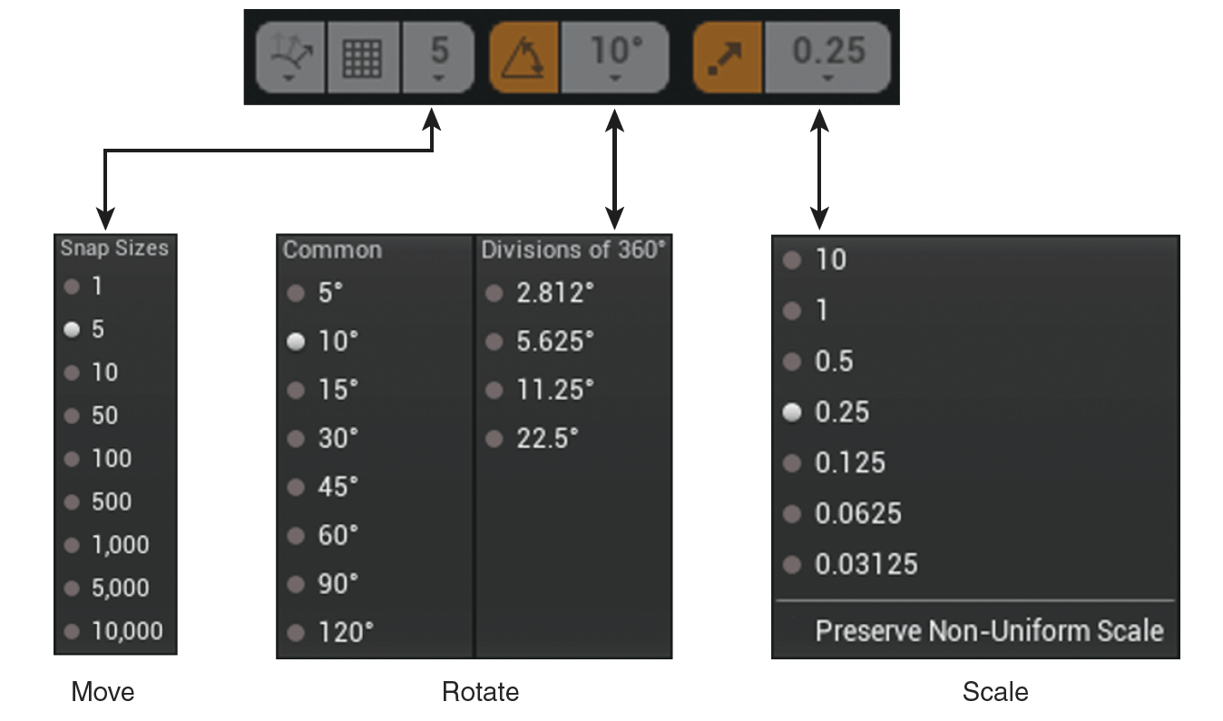
Snapping to the Grid
There are three types of transformation snap types: Move, Rotate, and Scale. Each grid system has its own unique snapping measurements that can be set at the top of the Level Viewport located next to the correlating type of transformation.
Drag grid: The movement grid uses multiples of 5 and corresponds directly to the UE4 grid spacing.
Rotation grid: Rotation movement is based on scalar degrees of multiples of 5, using the most common rotation angles: 5 degrees, 10, 15, 30, 45, 60, 90, and 120. There is also a secondary menu that lists divisions of 360 degrees, starting at 2.812 and ascending to 5.625, 11.25, and 22.5.
Scale grid: Scaling scales down by halves, and it starts with 10 and descends to 1, .5, .25, .125, and so on.

Slide 16
Snapping to
the Grid
You can adjust the scale values for a grid type by selecting the numeric value located next to the corresponding symbol. The drop-down list then offers multiples of the base value to select from.
You can toggle on and off each of these snaps by simply clicking on the symbol for the transformation. The symbol is highlighted orange when it’s active, and it is gray when disabled.
While the symbol is disabled, you can manipulate the Actor in the corresponding transform method with no snapping constraints.

Slide 17
Organizing a Scene
When you’re working on a project, the number of Actors involved is likely to grow substantially in a short time. Therefore, it is vital that Actors within a scene or Level can be found easily and efficiently.
The following sections discuss some of the parts of UE4 that help you stay organized while building a project.

Slide 18
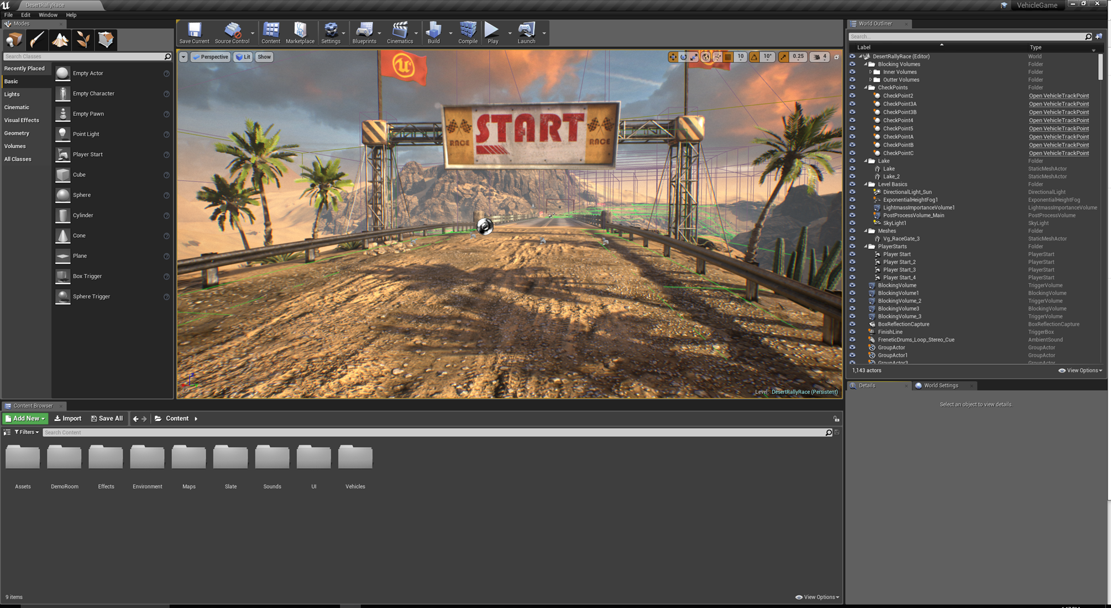
World Outliner
The World Outliner enables you to find Actors within the scene. All Actors in the scene are listed and searchable through the search bar at the top of the World Outliner panel.
You can use the search bar to search the whole scene or look for specific types of Actors within the scene.
You can also exclude words from your search by adding the - character before a keyword search.

Slide 19
World Outliner
The main UE4 tool for effective Actor organization is the World Outliner. You use the World Outliner panel to organize all aspects of a scene into one easy-to-read menu. By default, it appears in the top-right corner of the screen when you open a project.
You can also open the World Outliner by going to the main menu bar and selecting Window > World Outliner.
Each Actor in the World Outliner is labeled with its given name or label, such as the name the user has given it or the default one that it was given after being placed in the scene, and the type of Actor it is, such as Static Mesh or Light.
There is an icon beside each Actor to help describe its type.

Slide 20
World Outliner: Attaching
Attaching Actors to one another allows you to create a parent-child relationship between them.
Once two Actors have been attached, one will be the parent and the other the child.
The child Actor’s transforms become relative to those of its parent. This means that when you move, scale, or rotate the parent, the child will follow. However, changing the transforms of the child Actor does not affect its parent.
A parent can have any number of child Actors attached to it, but a child can have only one parent.

Slide 21
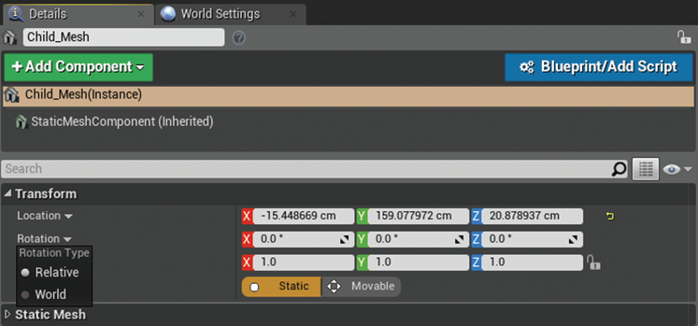
World Outliner: Attaching
To attach one Actor to another, select the Actor you want to be the child in the World Outliner by clicking on its name and dragging it onto the name of the Actor you want to be the parent.
To break an attachment, in the World Outliner click and drag the child back onto the parent’s name.

Slide 22
World Outliner: Folders
The World Outliner is organized in much the same way as your computer’s file browser. There are individual files and groupings of files in folders, and folders can be organized and nested inside one another.
At the top right of the World Outliner panel is a small icon that is a plus symbol on a folder. Click this icon to add a new folder to your World Outliner and name it.

Slide 23
World Outliner: Groups
You can group Actors in a scene by clicking one Actor and holding down the Ctrl key as you click other Actors you want to add to the grouping.
Then you can right-click any of the selected Actors and select Group from the context menu.
You can also use the shortcut key Ctrl+G to group the selected Actors together.
Grouping is another easy way to quickly organize aspects of a project within a scene.
Grouping is similar to using folders, in that it turns a selection of Actors into an individually placed Actor on the World Outliner.
By grouping together a set of Actors, you can move, scale, and rotate them all at one time.
When you apply movement, scaling, or rotation to a group of Actors, the transformations apply to the center of all the Actors in the group; it’s important to keep this in mind if you decide to group Actors that are far apart within a scene.

Slide 24
World Outliner:
Groups
A few options allow you to change how a group is set up. Each group can be unlocked and locked. By default, all groups created are locked, which means all the parts of it transform as one unit.
To manipulate each part inside a group, right-click the group to open the context menu and select Groups > Unlock. While the group is unlocked, you can manipulate the Actors in the group individually.
When you are done making changes, you can lock the group again by right-clicking any of the Actors in the group and selecting Lock Group. This resets the constraints of the Actors to act as one Actor group again.

Slide 25

layers
Another method for keeping your project organized is the layer system. In UE4, the layer system is similar to the systems in 3D programs such as Maya or Max.
To access the Layers panel, select Window > Layers from the main menu.
In this panel, you can control what parts of the scene are grouped into layers and can be toggled on and off.
When you right-click in the Layers panel, all available options for creating a new layer, such as New Layer, are available.

Slide 26
layers
You can add Actors in a scene to layers in a couple of ways:
Click names of Actors in the World Outliner and left-click and drag them to the appropriate layer in the Layers panel.
Select all the Actors you want to add to a layer, right-click that layer in the Layers panel, and select Actors to Layer from the context menu provided.
You can also remove previously added Actors from layers: Right-click an Actor and select Remove Selected Actors from Layer from the context menu.

